Slide 1


Analysis on Tablets Specification on Prices and Customer Review
Presented
By
Neha Nakhate

Slide 2


About Me
I am Neha Nakhate, Aspiring Data Analyst, from Innomatics Research Lab and Graduated in 2021 with B.A in Psychology, passionate about data-driven insights.
GitHub
LinkedIn

Slide 3

✔ Problem Statement ✔ Flow of Web Scraping
✔ Introduction to Dataset ✔ Tablet Price Distribution ✔ Tablet Prices w.r.t Brands ✔ Top Tablet Brands ✔ Top Tablet Features (RAM, Storage, Battery, etc.) ✔ Brand-wise Feature Comparison ✔ Impact of Ratings and Reviews on Prices ✔ Correlation between Features and Price ✔ Best Value-for-Money Tablets ✔ Top-Rated Tablets ✔ Target Customers (Budget vs. Premium Buyers) ✔ Future Scope ✔ Conclusion

Slide 4
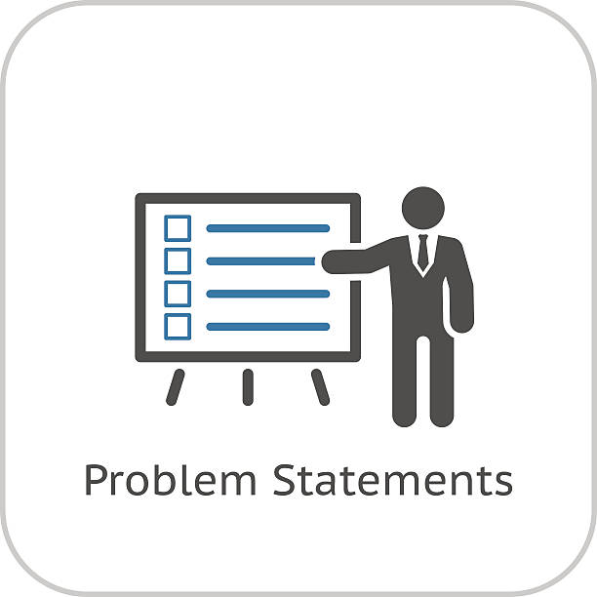
Problem Statement
“Analyzing Tablet Prices and Features”
The problem I chose is around tablets. There are so many tablets available in the market, and it's really confusing for customers to pick the right one. So in this project, I analyzed how factors like brand, storage, RAM, battery, and customer reviews affect tablet prices. The idea is to find price patterns and help customers make better choices, and also give businesses insights for better pricing and marketing.

Slide 5
Web Scrapping
4
Important Steps
To Follow :
Store and Process the Data
Extract the Data
Data Frame Creation
Regx patterns
Parse HTML Content
Requests.get()
Parsing
find all()
Import Libraries
Requests
Beautiful Soup
Regx

Slide 6
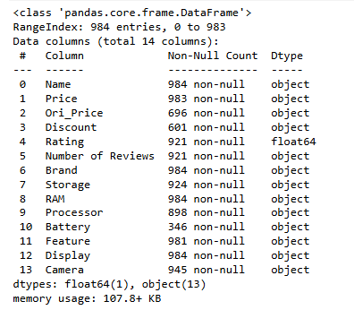
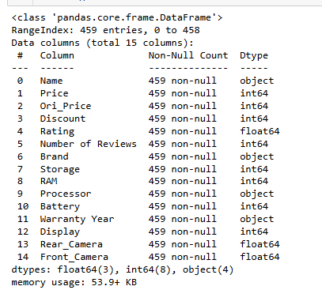

Intro to Dataset
Row Data
Clean Data

Slide 7
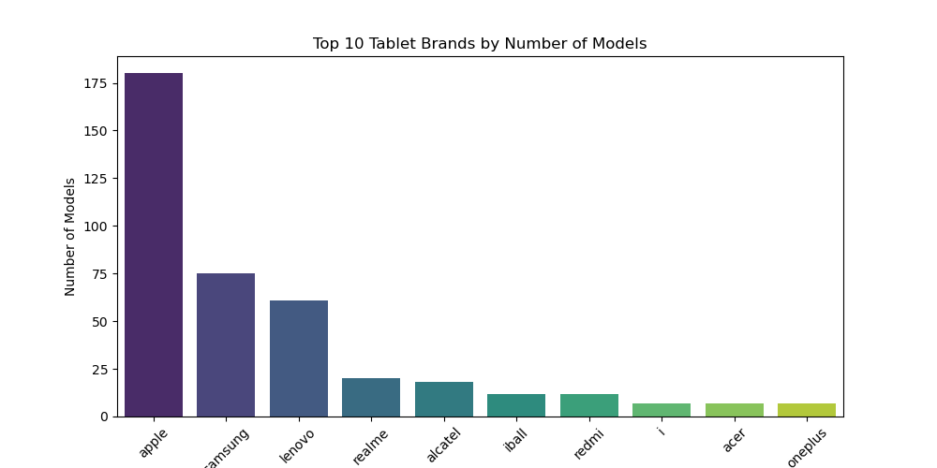
Top 10 Brands
I compared the tablet prices across different brands. This helped identify which brands are selling premium models and which ones are more budget-friendly. It’s useful for both customers and companies to understand the market better

Slide 8
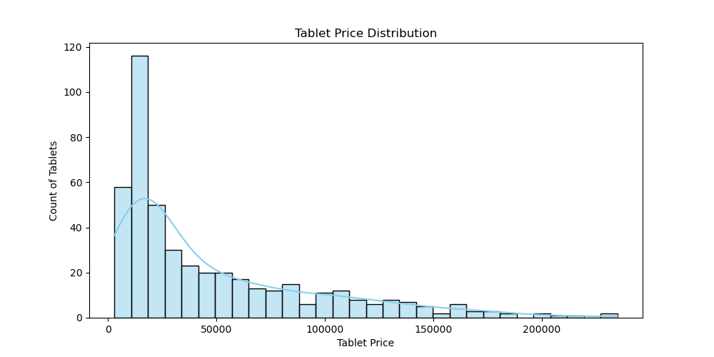
Tablet Price Distribution
When I looked at the price distribution, I found that most tablets are priced between ₹0 to ₹50,000. This shows that there is high demand for mid-range tablets and a healthy, balanced market in this price range.

Slide 9
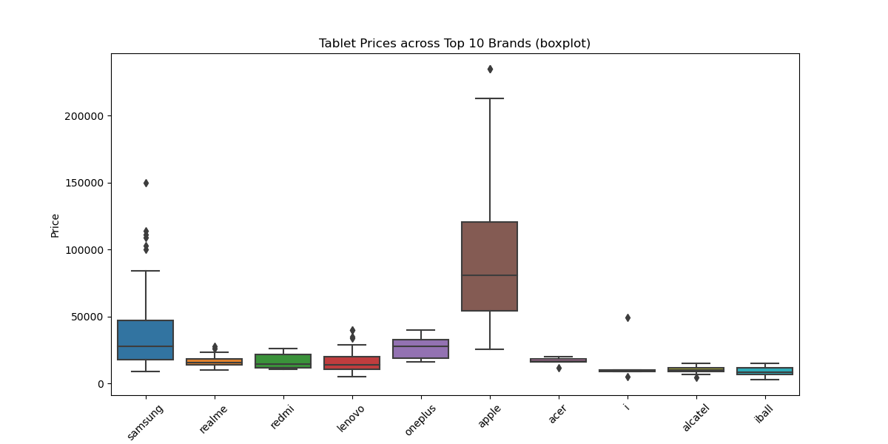
Tablet Prices w.r.t Brands
Shows how tablet prices differ by brand, helping buyers find affordable or premium options and guiding brands to set better prices.

Slide 10
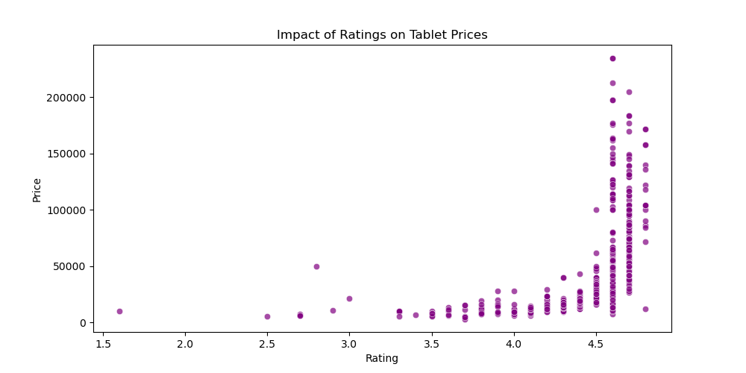
Impact of Ratings on Prices (Scatter Plot)
This scatter plot shows how tablet prices relate to customer ratings, helping us see if pricier tablets get better ratings or if cheaper ones are also well-liked.

Slide 11
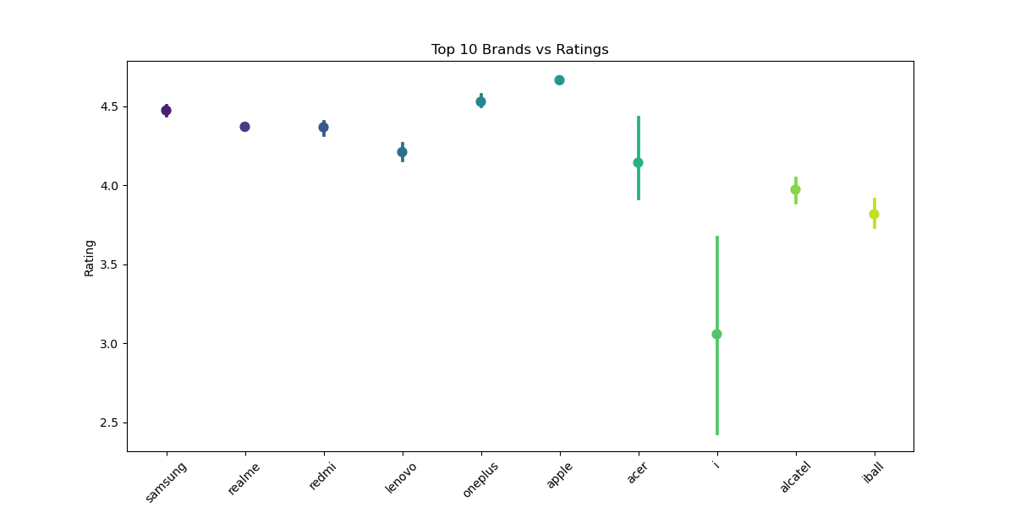
Impact of Brand vs Ratings (Pointplot)
This chart shows how different tablet brands are rated by customers. It helps identify which brands offer the most satisfaction. Higher ratings mean better performance and happy users.

Slide 12
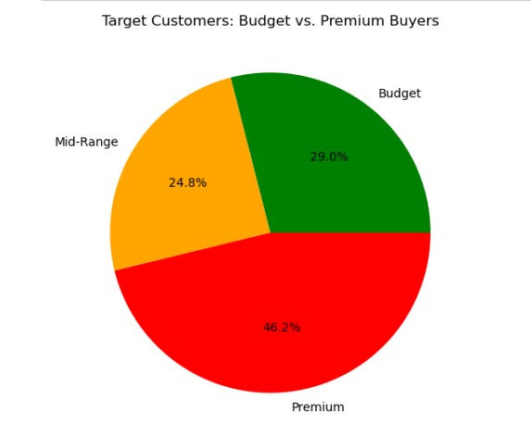
Target Customers (Budget vs. Premium Buyers - Pie Chart)
The pie chart shows how many customers buy budget tablets and how many prefer premium ones. This helps businesses understand what most people are looking for and plan their products better.

Slide 13
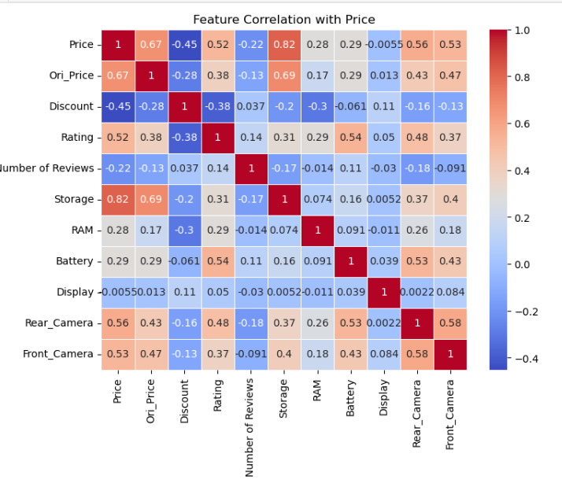
Correlation between Features and Price (Heatmap)
The heatmap visualizes the correlation between different tablet features and their prices. It highlights which specifications (RAM, storage, battery, etc.) have the most influence on price. A higher correlation suggests a stronger impact on pricing, helping businesses and customers understand value-driving features.

Slide 14
End Users
Consumers :
Helps buyers choose the best tablet based on price, features, and reviews.
Brands & Manufacturers:
Provides insights for improving tablet features and pricing. Retail Platforms :
Assists e-commerce sites in optimizing recommendations.
Tech Analysts & Researchers :
Offers data to analyze market trends in the tablet industry.

Slide 15
Future Scope
More Tablet Types: Explore more models and versions.
Smarter Review Analysis: Use AI to understand reviews better.
Live Price Tracking: See real-time price changes.
Price Prediction: Forecast future tablet prices.
Global Comparison: Compare tablets from different countries.

Slide 16
Conclusion
Found the best value-for-money tablets.
Identified key features affecting prices.
Understood budget vs. premium buyers.
Compared top brands and ratings.
Suggested future improvements.

Slide 17
Any Questions ?

Slide 18

THANK YOU

